Slide 1
SPORTS vs. ESPORTS
5 Year Viewership Comparison
Ben Bowling Haslett Fernandes Matthew Geiger Matthew Leopold Josh Samuel

Slide 2






This Photo by Unknown Author is licensed under CC BY-SA
This Photo by Unknown Author is licensed under CC BY-SA-NC
This Photo by Unknown Author is licensed under CC BY-SA-NC

Slide 3


Theme
This Photo by Unknown Author is licensed under CC BY-ND

Slide 4

Project Background
Does investment in Esports make sense based on viewership data
Will gaming become a viable commercial pursuit?
NFL is the dominant TV establishment
Esports is a younger field
Will the Esports growth help it overtake NFL viewership numbers
This Photo by Unknown Author is licensed under CC BY-SA

Slide 5
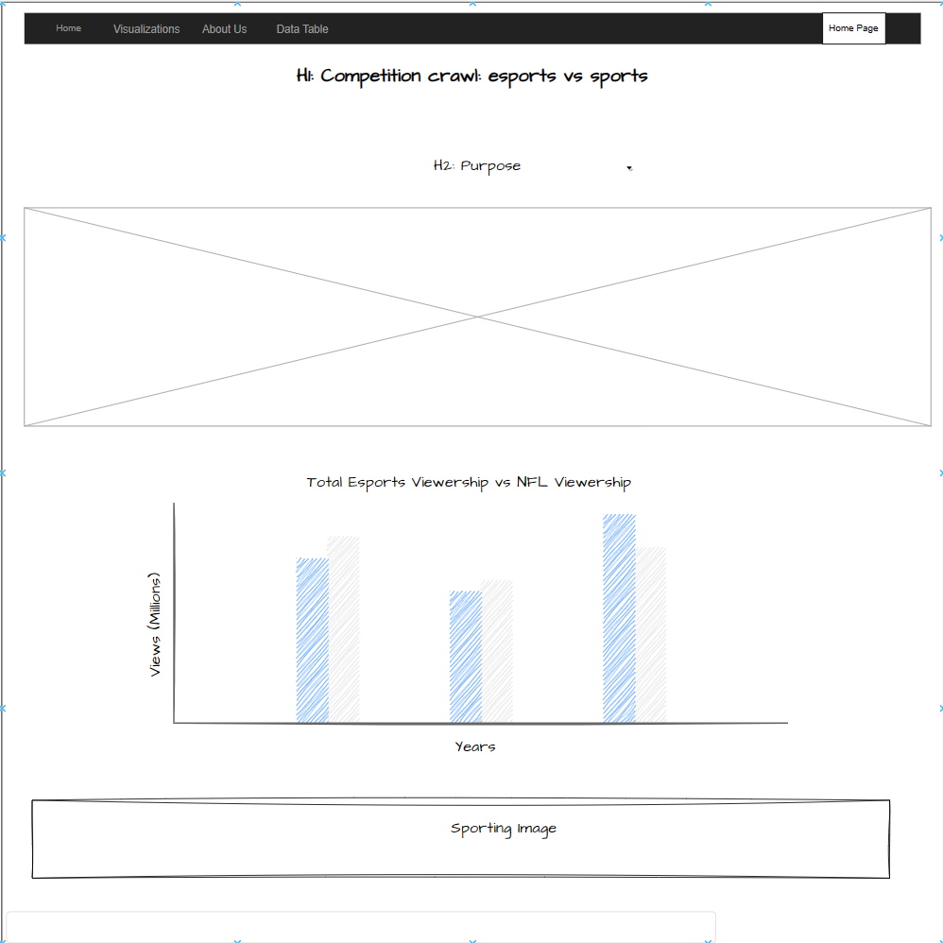
Wireframe
The team created a wireframe to help create a structure for the user interface

Slide 6
Coding Approach
Google, Trial, and Error

Slide 7

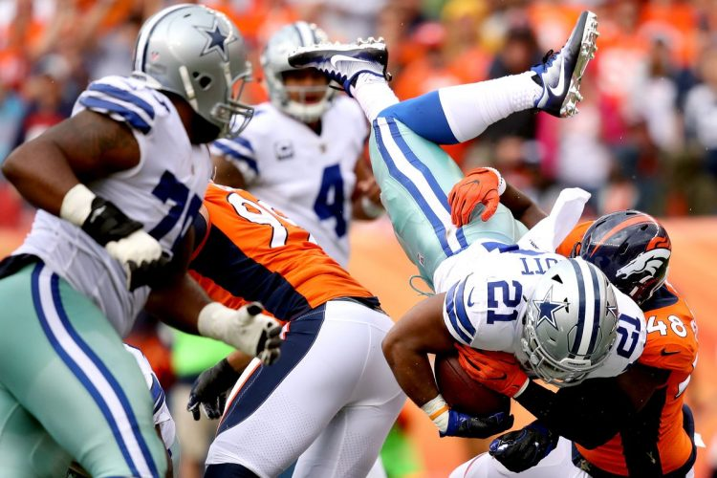
ELT
To best handle the sports vs. esports comparison, the team decided to create a dashboard page with multiple charts that update from the same data
The team data scraped websites to collect both the NFL and Esports viewership data
This Photo by Unknown Author is licensed under CC BY
This Photo by Unknown Author is licensed under CC BY-NC-ND

Slide 8
Data Wrangling
Wrangler, please sponsor us. We are just students who need new jeans.

Slide 9

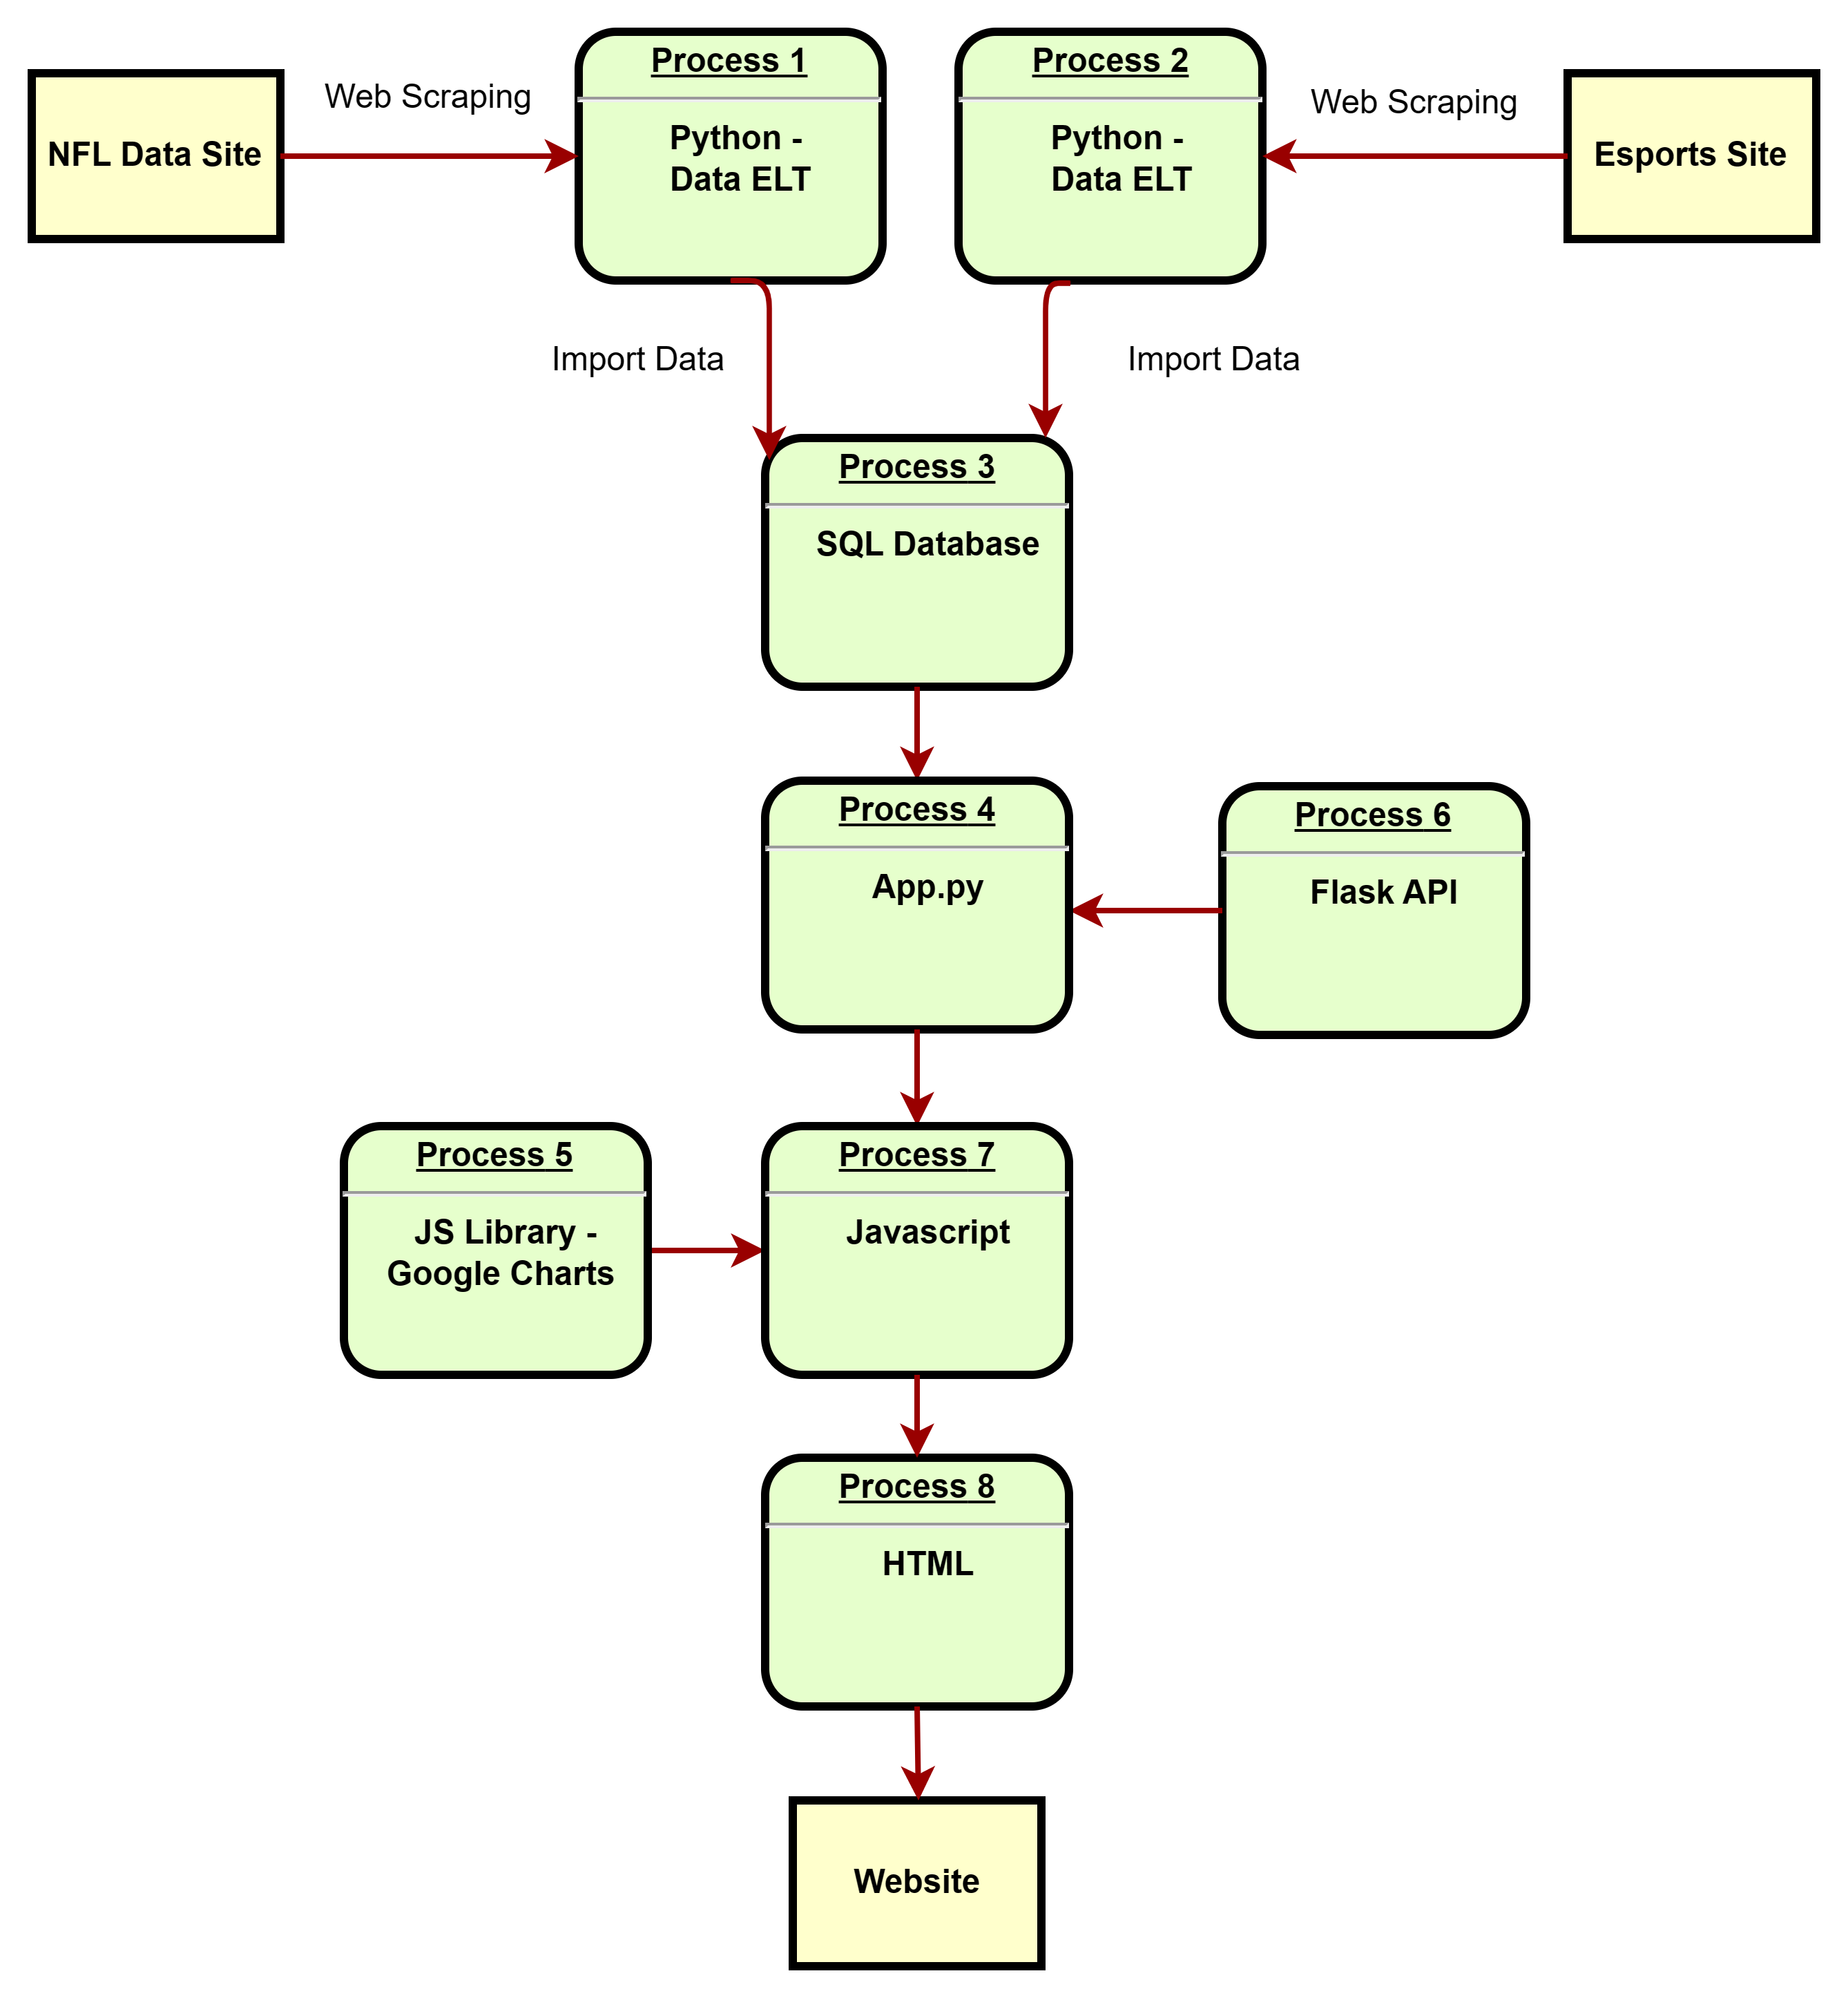
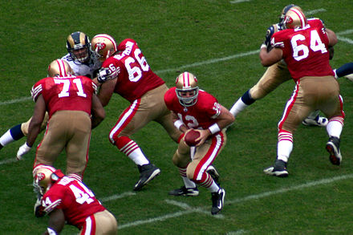

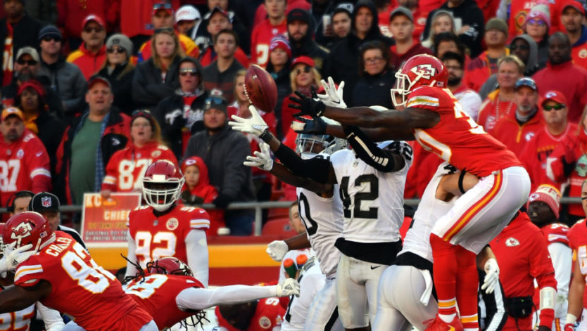

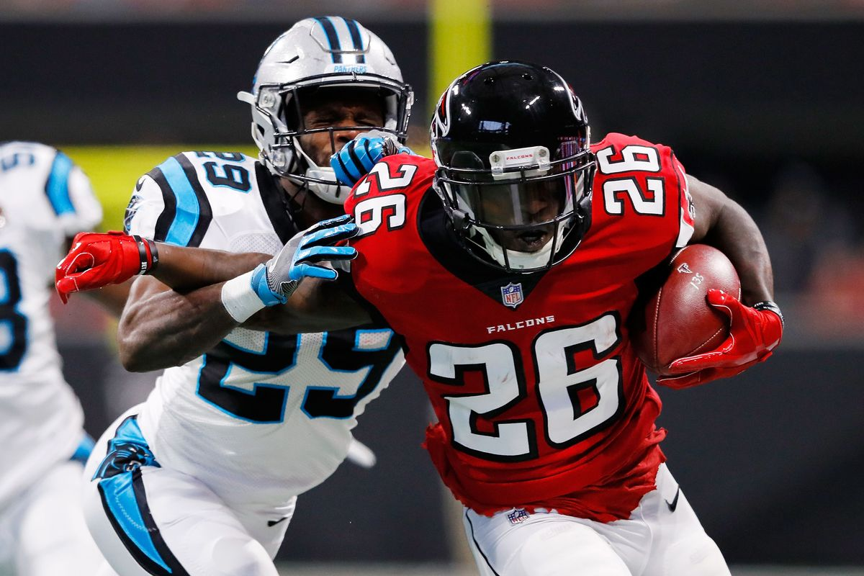
Data Flow
This Photo by Unknown Author is licensed under CC BY-SA
This Photo by Unknown Author is licensed under CC BY-SA
This Photo by Unknown Author is licensed under CC BY
This Photo by Unknown Author is licensed under CC BY-ND
This Photo by Unknown Author is licensed under CC BY-SA-NC
This Photo by Unknown Author is licensed under CC BY-ND

Slide 10

Database and Datasets
The team decided to use PGAdmin and SQLAlchemy for the database
The dataset includes 5 years of data for Esports and NFL viewership
2017-2021
The Esports data includes viewership data each year for 50-100 games
The NFL data includes viewership data for all the regular season games each year
This Photo by Unknown Author is licensed under CC BY-NC-ND

Slide 11
Final Visualization
An absolute beauty

Slide 12
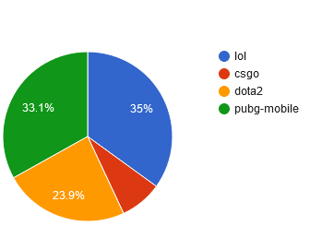
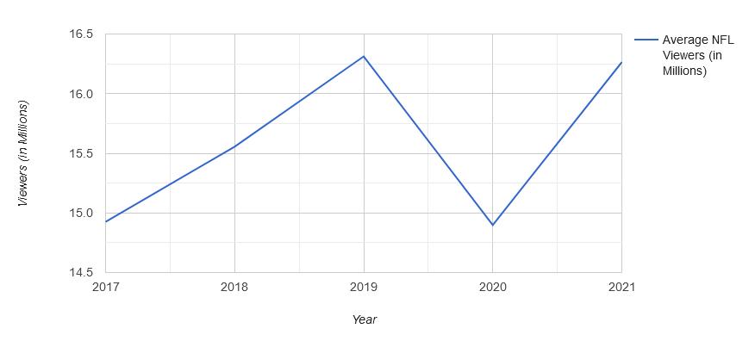
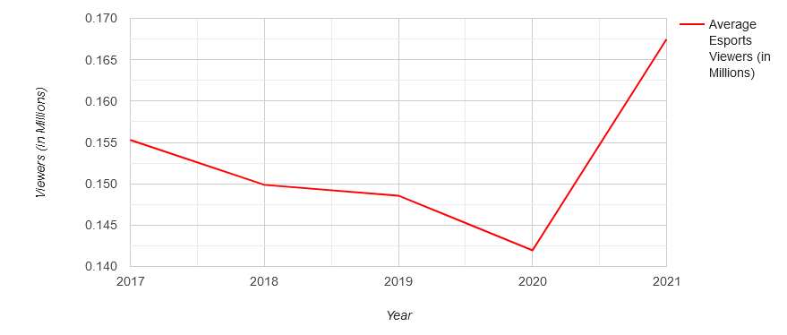
Google Charts
The team used Google Charts as the new JavaScript library

Slide 13
Data Sources
NFL
2021 NFL television ratings, viewership - Sports Media Watch
2020 NFL television ratings, viewership - Sports Media Watch
2019 NFL TV ratings and viewership - Sports Media Watch
2018 NFL TV ratings and viewership - Sports Media Watch
2017 NFL TV Ratings - Sports Media Watch
Esports
Most Popular Esports Games 2021 | Esports Charts (escharts.com)
Most Popular Esports Games 2020 | Esports Charts (escharts.com)
Most Popular Esports Games 2019 | Esports Charts (escharts.com)
Most Popular Esports Games 2018 | Esports Charts (escharts.com)
Most Popular Esports Games 2017 | Esports Charts (escharts.com)

Slide 14
Website Tour

